Slide 1
Black History Month 2008
Mr. Clutter
VMS Library

Slide 2
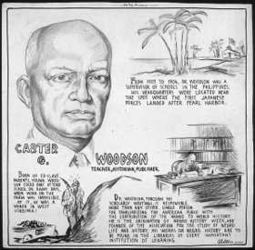
Introduction
►Carter G. Woodson was an African American historian, author, journalist and
the Founder of Black History Month. He is considered the first to conduct a
scholarly effort to popularize the value of Black History. He recognized and acted
upon the importance of a people having an awareness and knowledge of their
contributions to humanity and left behind an impressive legacy. He was a member
of the first black fraternity Sigma Pi Phi and a member of Omega Psi Phi as well.
►1926 - began as Black History Week
►1976 - established as Black History Month

Slide 3
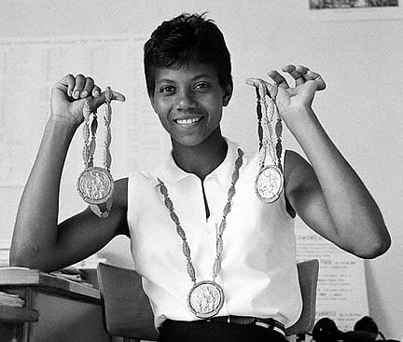
Famous Black Women
Bessie Coleman:
►1893 - 1926
►First Black women pilot 1921
Wilma Rudolph:
►1940 - 1994
►First American women to win 3 gold medals (1960)
Marian Anderson:
►1897 - 1993
►was denied the right to sing at Constitutional Hall – Washington DC

Slide 4
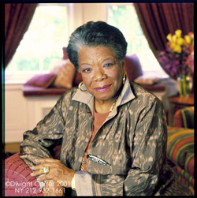
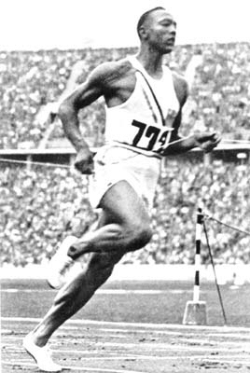
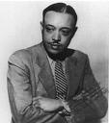
Arts, Literature, Medicine & Athletics
Maya Angelou:
►1928 -
►Poet and writer {6 autobiographies}
Jesse Owens
►1913-1980
►He won four gold medals in Track and Field at the 1936 Olympics
Aaron Douglas:
►Famous painter of library murals.
►1899 - 1979
Dr. Hale Williams
►1856 - 1931
►1893 he repaired the torn pericardium of James Cornish, who had suffered a knife wound to the heart

Slide 5
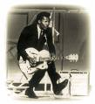
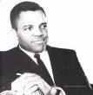
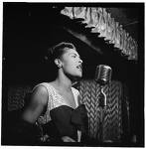
Black Musicians
► Armstrong, Louis “Satchmo” (Daniel Louis Armstrong), 1901–1971, American jazz trumpet virtuoso, singer, and band leader.
► Berry, Chuck (Charles Edward Anderson Berry), 1926- , American rock music, guitarist, singer and songwriter.
► Berry Gordy, 1929- In 1959 he founded the Motown Record Corporation. The early hit-makers included: the Supremes, the Four Tops, the Temptations, and Martha and the Vandellas and the Jackson 5.
► Holiday, Billie, 1915-59, American singer. Her birth name was Eleanora Fagan. She sang with many famous jazz muscians. She died at a an early age and the movie “Lady Sings the Blues” is based on her life.

Slide 6
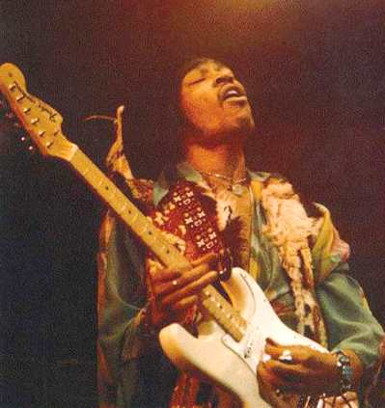
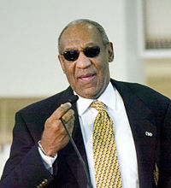
Black Entertainers
► Jimmy Hendrix – (1942 – 1970) was a singer, guitarist and song writer and is considered to be one of the greatest and most influential guitarist in rock history.
He helped develop the technique of guitar feedback and overdriven amplifiers.
► Oprah Gail Winfrey (1954 - ) is the American multiple-Emmy Award winning host of The Oprah Winfrey Show, the highest-rated talk show in television history. She has been ranked the richest African American of the 20th century,the most philanthropic African American of all time, and the world's only black billionaire for three straight years.
►William Henry "Bill" Cosby, Jr., Ed.D. (1937 - ) is an American comedian, actor, television producer, activist, and luminary. He received the 3 Emmy’s, 2 Golden Globe Awards and 9 Grammy Awards

Slide 7
This powerpoint was kindly donated to www.worldofteaching.com
http://www.worldofteaching.com is home to over a thousand powerpoints submitted by teachers. This is a completely free site and requires no registration. Please visit and I hope it will help in your teaching.

